Slide 1
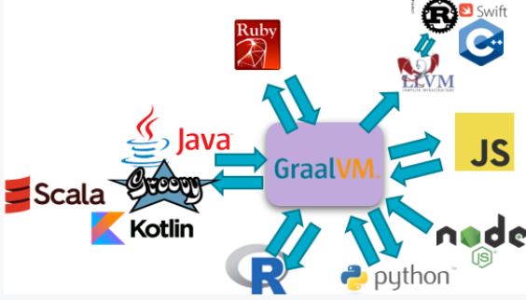

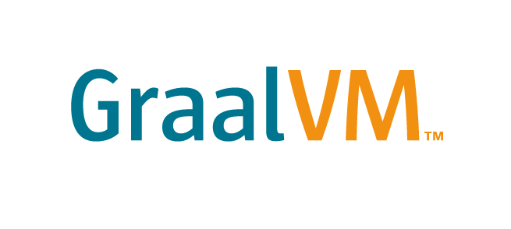

Getting Started with GraalVM Polyglot Programming
Developer MeetUp – 14th November 2019
Lucas Jellema, CTO & Architect AMIS, Oracle Groundbreaker Ambassador
Workshop Resources: http://bit.ly/graal1411

Slide 2
Overview
Lean Run Time
Native Binary
Executables
Custom DSL
Polyglot
Serverless Java
JavaScript, Python, Ruby, R, C/C++
Next Gen JIT Compiler
Notes:
Overview of main themes and topics
(instead of boring list of all topics in the agenda)
We can make this slide build – to indicate the order of the topics
High-performance modern Java
Low-footprint, fast-startup Java
Combine JavaScript, Java, Ruby, and R

Slide 3

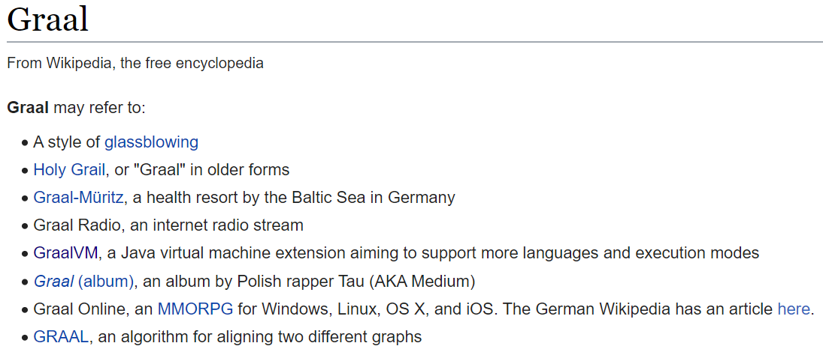
What is GraalVM?
Notes:
Spaghetti…
Hotspot C2 compiler for runtime optimizations had gotten very complicated and very hard to maintain. It does not support optimization for modern code patterns. The C++ code had gotten out of hand

Slide 4

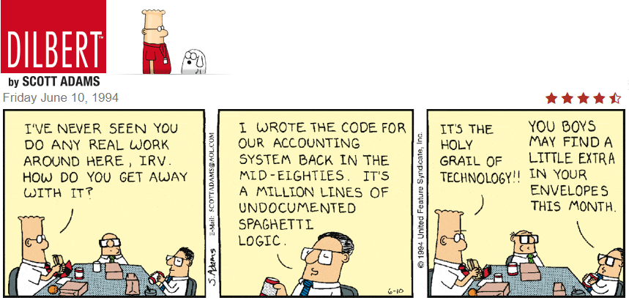
What is GraalVM?
Notes:
Spaghetti…
Hotspot C2 compiler for runtime optimizations had gotten very complicated and very hard to maintain. It does not support optimization for modern code patterns. The C++ code had gotten out of hand

Slide 5
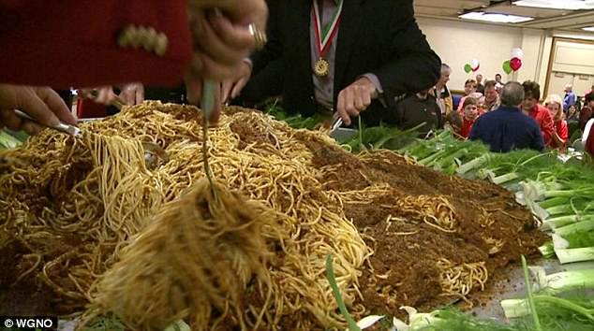
Oh boy, we will be in so much trouble…
Notes:
Spaghetti…
Hotspot C2 compiler for runtime optimizations had gotten very complicated and very hard to maintain. It does not support optimization for modern code patterns. The C++ code had gotten out of hand

Slide 6
Introducing
JIT Compiler for running Java applications faster (matching native languages for speed)
Embeddable on Hotspot VM or other JVMs
Polyglot VM – for running applications in any language
JavaScript, Ruby, R, Python, C/C++
Ahead-of-Time compiler for creating native binaries
Simple, lean runtime with fast startup and minimal memory and process footprint
Interoperability platform that allows applications in one technology to interact with with modules in other technologies (“Nashorn on super steroids”)
Framework for compiling, running, interoperating and natively compiling applications written in your own DSL
Set of cross-language programming tools
Notes:
https://en.wikipedia.org/wiki/GraalVM

Slide 7
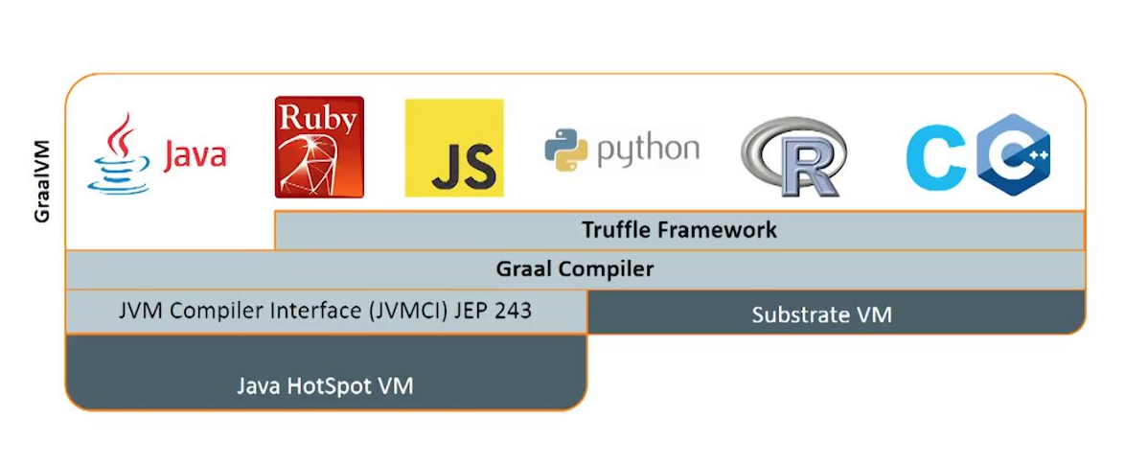
What is GraalVM?
Custom DSL
Native Image
Polyglot Tools

Slide 8

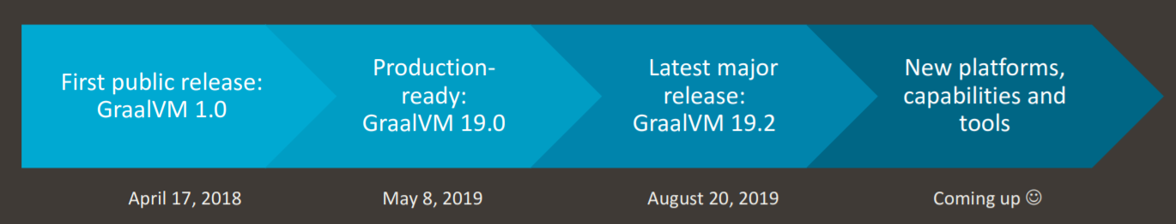


Some history on GraalVM
Proof of Concept: a compiler written in Java (with all its software engineering advantages) could generate highly optimized code without compromising on compile times
Project spun off from Maxine VM
2012
Twitter started to run its many Scala applications on the GraalVM JIT Compiler to save money and CPU cycles
Dutch National Police adopted GraalVM and FastR for Scala ⬄ R Data Science projects (as presented on JFall 2019)
2017
2019
Notes:
https://openjdk.java.net/projects/graal/

Slide 9
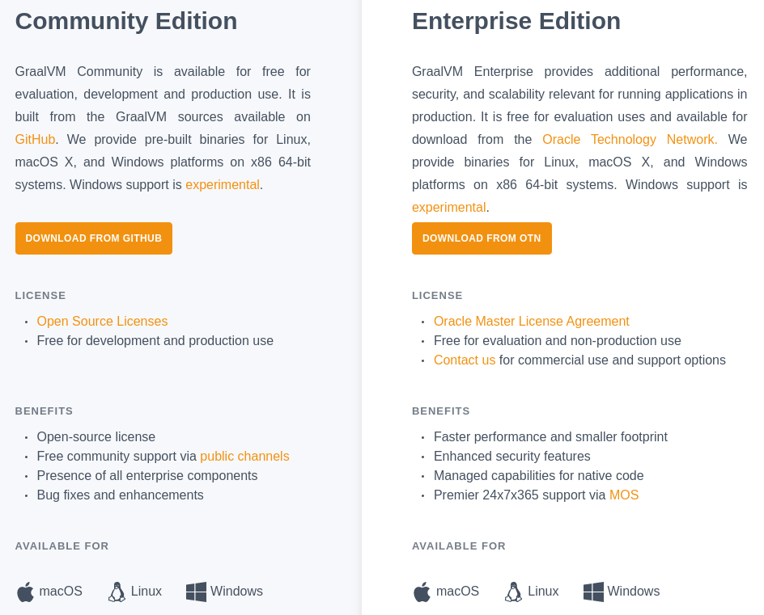
GraalVM: Two Editions
Notes:
Spaghetti…
Hotspot C2 compiler for runtime optimizations had gotten very complicated and very hard to maintain. It does not support optimization for modern code patterns. The C++ code had gotten out of hand

Slide 10
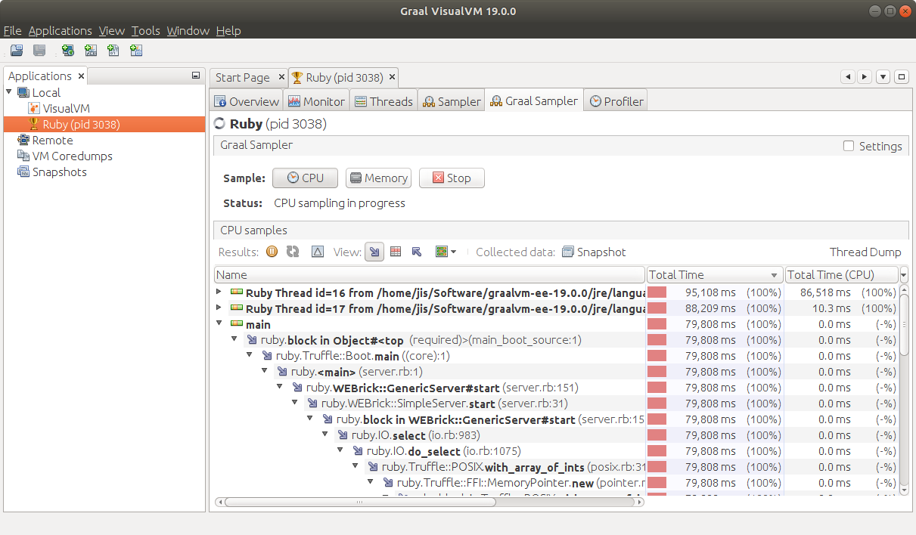
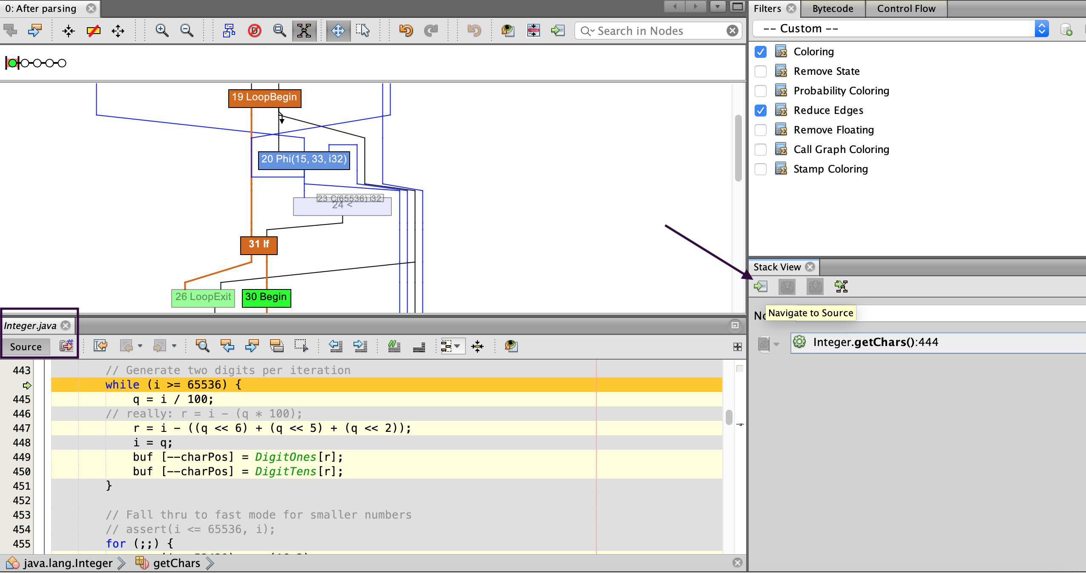
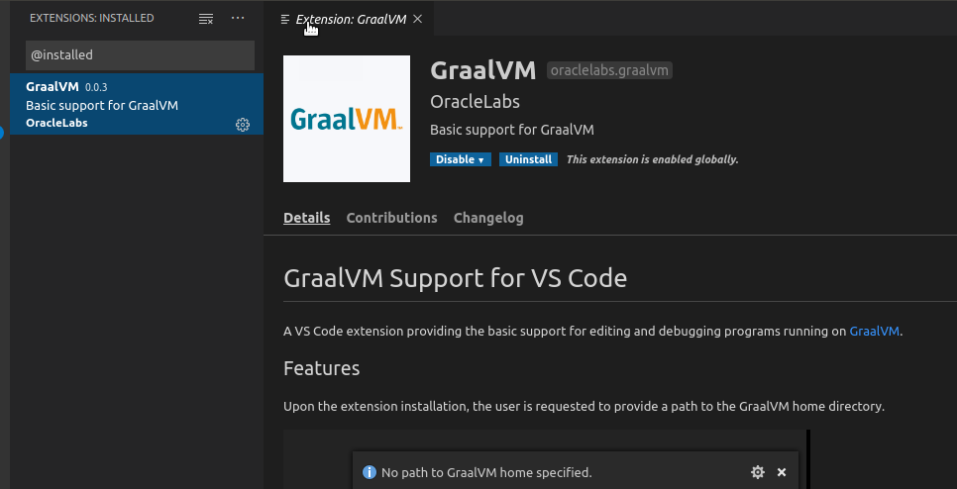
Tools in the GraalVM Ecosystem
Debugger linked to Chrome DevTools
Profiler – command line CPU Sampler, CPU tracer and Memory tracer
Graal VisualVM – Visual CPU Sampler, Heap Analyzer
Visualizing Java Flight Recorder data
Ideal Graph Visualizer
view and inspect interim graph representations from GraalVM and Truffle compilations
Visual Studio Code Extensions
Editing and debugging applications running on GraalVM
Notes:
https://visualvm.github.io/graal.html
https://github.com/oracle/graal/tree/master/vscode/graalvm
https://www.graalvm.org/docs/reference-manual/tools/#visual-studio-code-extensions-for-graalvm
https://www.graalvm.org/docs/reference-manual/tools/

Slide 11
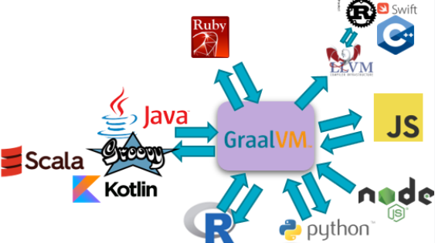

Polyglot Platform with Language Interoperability
#jfall

Slide 12

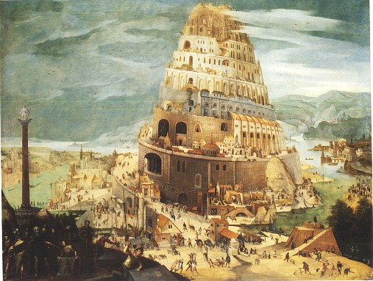

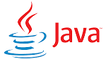


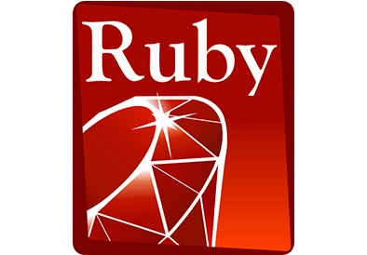

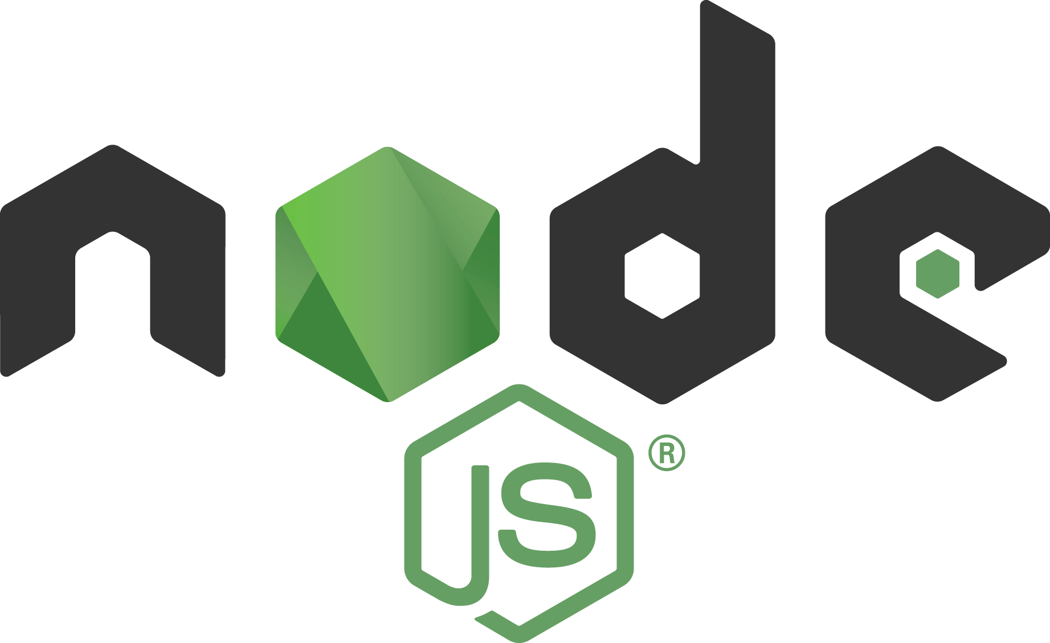



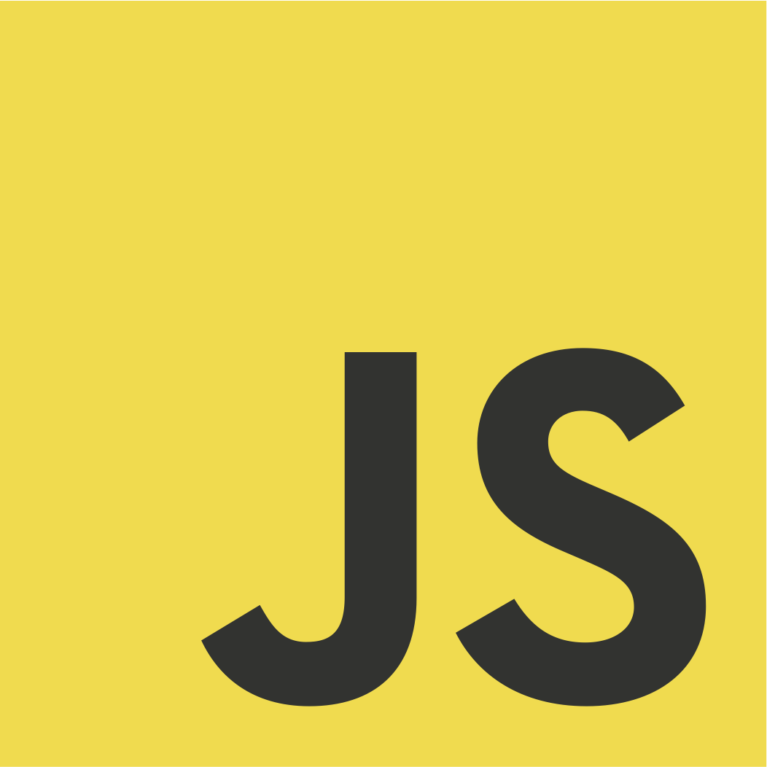





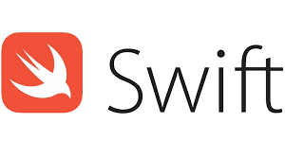
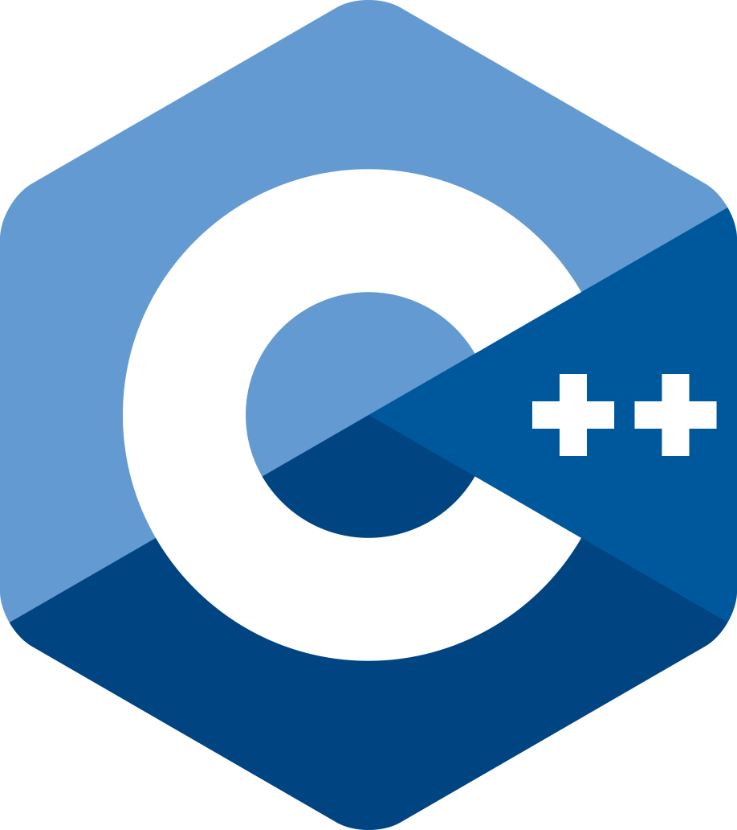



Why do we have so many languages?
Notes:
Human Languages
Computer Programming Languages
(personal taste, libraries, suitability for certain tasks, legacy)
Office politics, commercial

Slide 13


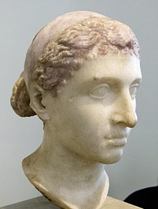

Polyglots – speak and understand many languages
Notes:
Human Languages
Computer Programming Languages
(personal taste, libraries, suitability for certain tasks, legacy)
Office politics, commercial

Slide 14


GraalVM Polyglot Runtime
GraalVM can run
Java
JVM Languages
Many other languages
Through Truffle produced intermediate code
Including Static Languages through Sulong- an LLVM IR interpreter
Your own Custom DSL
Truffle
Fortran
Haskell

Slide 15
Why use GraalVM as Polyglot Runtime?
Leverage Java runtime benefits for all language execution
Run Time Optimization from JIT Compiler
(possibly) Run Applications faster
Use Polyglot Tools in GraalVM ecosystem for debugging, tracing, profiling, …
Achieve seamless interoperability
Your own Custom DSL
Truffle
Fortran
Haskell

Slide 16


Polyglot Interoperability
Establish frictionless interaction between language contexts
To benefit from the best of all worlds
Call out to ‘other world’ in a native way
Receive response in interpretable format
Minimal hoops to jump through at design time
Minimal performance overhead at run time
Uncomplicated run time environment
Despite multiple runtime execution languages
Basically: polyglot with the ease of mono-glot

Slide 17
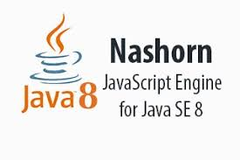
Current interoperability on JVM
Current interoperability options from Java:
file or queue based interaction,
REST API,
native interfaces (such as Java JNI and JNA),
JSR-223 Interoperability - for example Nashorn (and support for many other scripting languages);
intra-JVM, Java Byte code level interop between Java/Groovy/Kotlin/JRuby/Jython
Less than perfect: complex, suboptimal performance, technical limitations, variations in approach, complex runtime environments, complex testing

Slide 18

All languages are used to express and communicate very similar concepts
Meta Language (concepts, grammar, structure)

Slide 19
All programming languages are used to express and execute very similar concepts
Abstract Syntax Tree (variables, loops, conditions, calls, arithmetic)

Slide 20
GraalVM can merge and run Java Byte code derived from various origins
Fortran
GraalVM provides programming constructs in all supported languages to make Polyglot call-outs, evaluate embedded foreign code and share data across language contexts
Thus enabling interoperability
Haskell
GraalVM Polyglot

Slide 21
GraalVM Polyglot Interoperability
Java => JavaScript
Java => Any Truffle Language (Python, R, Ruby, JavaScript)
Native Image generation for Java Polyglot application
Node / JavaScript => Java
Node / JavaScript => Java => JavaScript
Any Truffle Language (Python, R, Ruby, JavaScript) ⬄ Any Truffle Language

Slide 22



The New Beast between Java and JavaScript
Out go Rhino and Nashorn
In comes GraalVM

Slide 23
From Java to JavaScript
Evaluate JS snippets
Load and call JavaScript sources
Exchange data and objects back and forth
Allow JavaScript to callback to Java objects
Run multiple JavaScript threads in parallel
Note: what applies to JavaScript by and large applies to all languages that can run on GraalVM through Truffle
Including Python, R, Ruby, LLVM (C/C++, Rust, Swift,…)
Your own DSL
Notes:
https://www.npmjs.com/package/validator

Slide 24
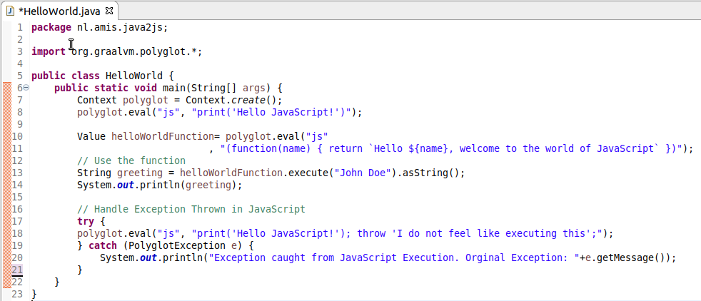
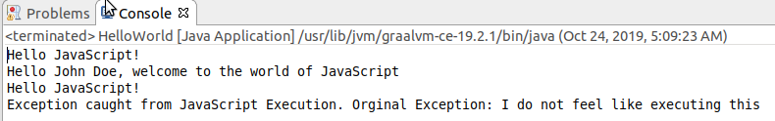
From Java to JavaScript Evaluate a Simple Code Snippet
Create Polyglot context
Evaluate Snippet
Evaluate Snippet => instantiate function
Execute function
Handle Exception from JS
JFall 2019 - HOW AND WHY GRAALVM
Notes:
https://www.npmjs.com/package/validator

Slide 25
Bindings interface between Java ⬄ JavaScript
JS Context
Bindings for sharing data objects and executable functions between the two language contexts
Bindings
invoke
function
put/call
variable
read/write
put/manipulate
Object
put/manipulate
read/write
Object
put/manipulate/call
invoke (method on)
Notes:
https://www.npmjs.com/package/validator

Slide 26
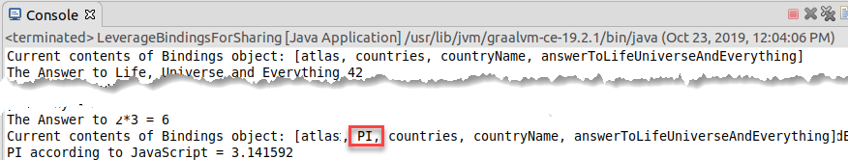
Bindings interface between Java ⬄ JavaScript Example: JavaScript constant, read from Java
Bindings
read
PI
write

Slide 27
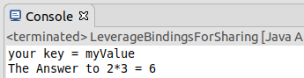
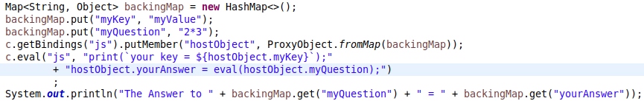
Bindings interface between Java ⬄ JavaScript Example: Java Map accessed from two sides
Bindings
hostObject
<Map>
put/manipulate
myKey
read
myQuestion
read
write
yourAnswer
Notes:
https://www.npmjs.com/package/validator

Slide 28
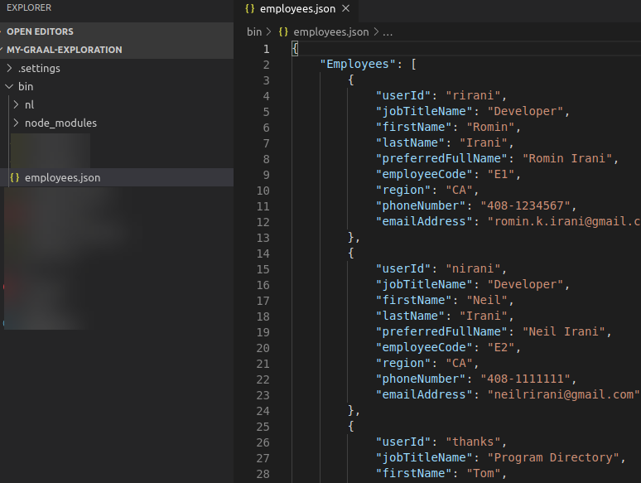
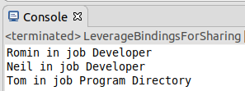
Bindings interface between Java ⬄ JavaScript Example: Leverage JavaScript for JSON processing (1/2)
Bindings
employees.json
eval
employees.json
read
Employees <Map>
put/write

Slide 29
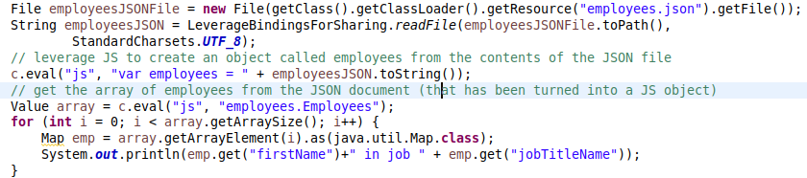
Bindings interface between Java ⬄ JavaScript Example: Leverage JavaScript for JSON processing (2/2)
Bindings
employees.json
eval
employees.json
read
Employees <Map>
put/write

Slide 30
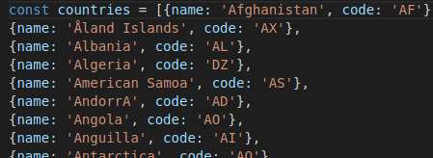
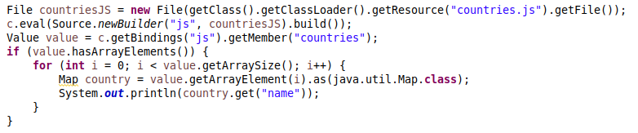
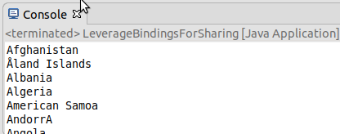
Bindings interface between Java ⬄ JavaScript Example: Read JavaScript Array elements from Java
Bindings
countries.js
countries.js
eval
read
Countries <array>
put/write

Slide 31
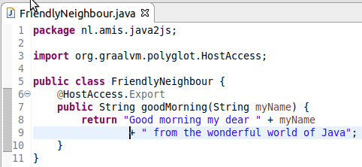
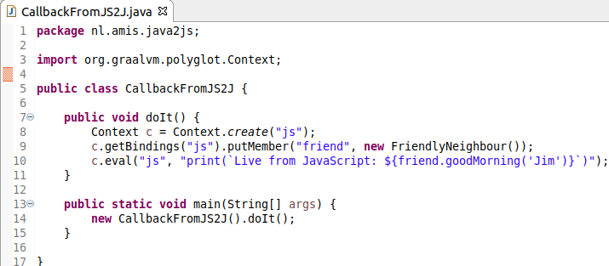
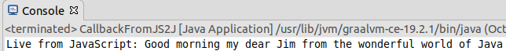
Call Back to Java from JavaScript
Bindings
friend <class Friendly Neighbour>
put
invoke
eval

Slide 32
Java ⬄ JavaScript GraalVM Rules for handling The Thread Gap
In a polyglot application, an arbitrary number of JS runtimes can be created, but they should be used by one thread at a time.
Parallel JavaScript execution can happily take place!
Data can be shared across multiple JavaScript contexts through Java
Concurrent access to Java objects is allowed: any Java object can be accessed by any Java or JavaScript thread, concurrently.
Java is well equipped to handle concurrent access to a Java Object
A single Java object can be accessed from multiple JS contexts
Concurrent access to JavaScript objects is not allowed: any JavaScript object cannot be accessed by more than one thread at a time.
Access to a shared Java Object (across JavaScript execution contexts) has to be synchronized in Java code
Notes:
Multi-threaded Java ←→JavaScript language interoperability in GraalVM
https://medium.com/graalvm/multi-threaded-java-javascript-language-interoperability-in-graalvm-2f19c1f9c37b
Example of JS calling Java and of using worker threads to communicate (background) events from Java to JS

Slide 33

Multiple JavaScript threads from a Single Multi-threaded Java Application
Context 1
Bindings
Main Thread
eval
Read/Update
Main Thread
put
cac <class CacheAndCounter>
Second Thread
Synchronized access
Second
Thread
eval
Synchronized access [to code snippets that need to access cac – an object shared with two context bindings]
Read/Update
Context 2
Bindings

Slide 34

A Typical Java Challenge (aided by JavaScript interaction)
Developing a Java application
I need to perform validations on input data
Postal Code (various countries), Mobile Phone Numbers (many countries), Email Address, Credit Card Number etc.
NPM Module Validator offers most of these OOTB
But… it is written in JavaScript
How does that help me?
Notes:
https://www.npmjs.com/package/validator

Slide 35
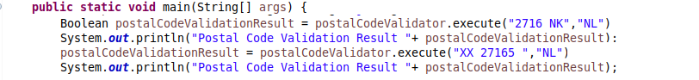
A Typical Java Challenge
Developing a Java application
I need to perform validations on input data
Postal Code (various countries), Mobile Phone Numbers (many countries), Email Address, Credit Card Number etc.
In Pseudo Code:
Notes:
https://www.npmjs.com/package/validator

Slide 36
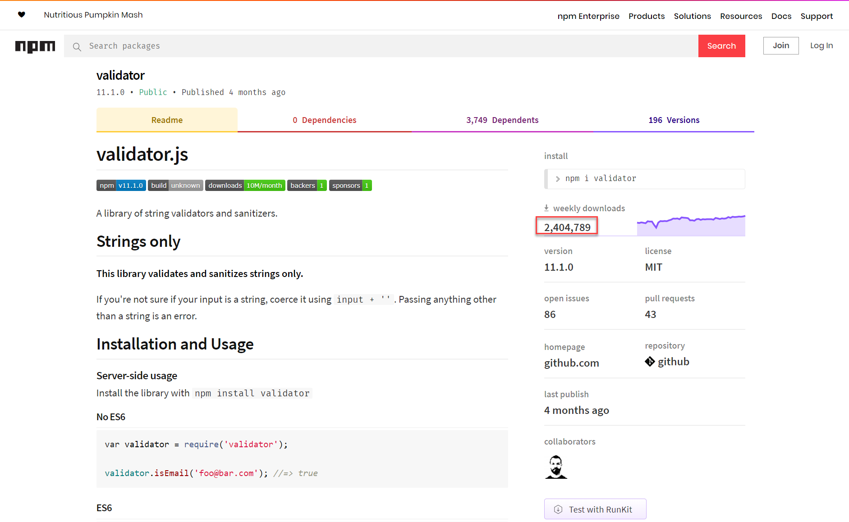
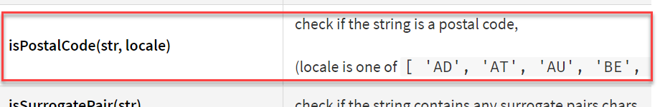
Community package in JavaScript for dozens of predefined validations
Notes:
https://www.npmjs.com/package/validator
https://www.graalvm.org/docs/reference-manual/compatibility/#validator

Slide 37
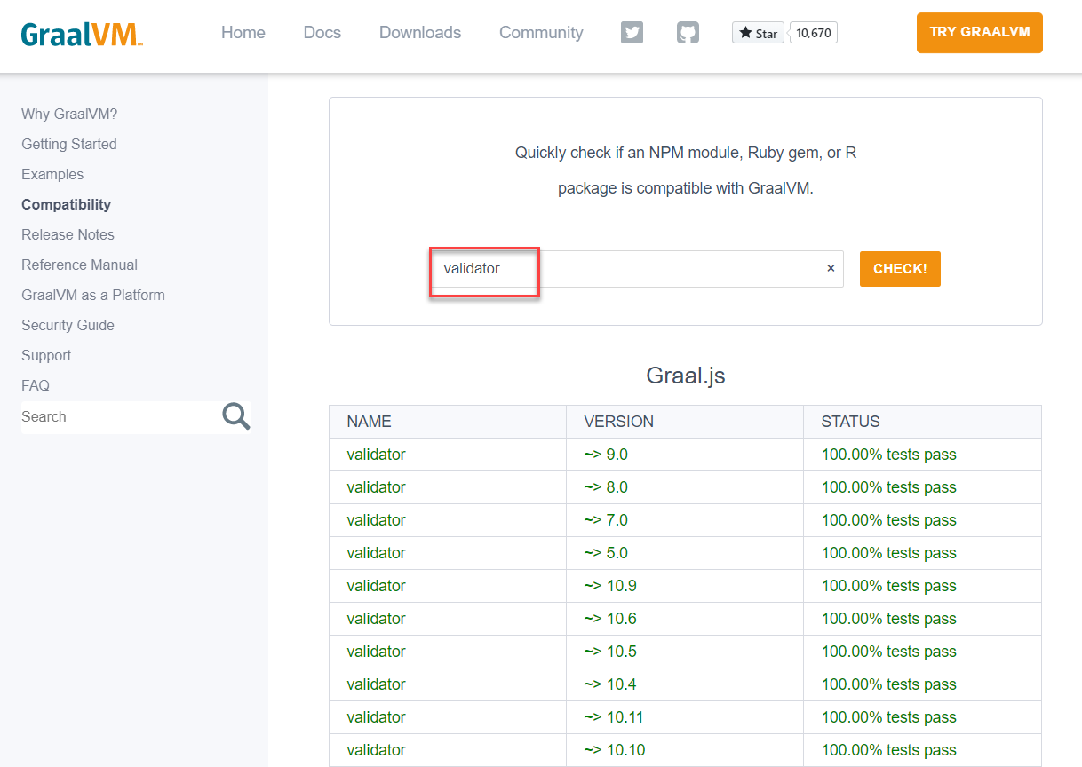
JavaScript Validator Module is compatible with GraalJS
Notes:
https://www.npmjs.com/package/validator
https://www.graalvm.org/docs/reference-manual/compatibility/#validator

Slide 38

A Typical Java Challenge – Resolved (with GraalVM)
Embrace GraalVM as the Java runtime
Install npm cli
Install npm module validator
After checking it is compatible
Install and use webpack to create a single bundle for module validator
Extend Java application
Import GraalVM Polyglot package
Create JavaScript Context
Load validator_bundled.js into context
Get desired JS functions from bindings map
Execute required JS functions
as if they were Java methods
Notes:
https://www.npmjs.com/package/validator
https://www.graalvm.org/docs/reference-manual/compatibility/#validator

Slide 39
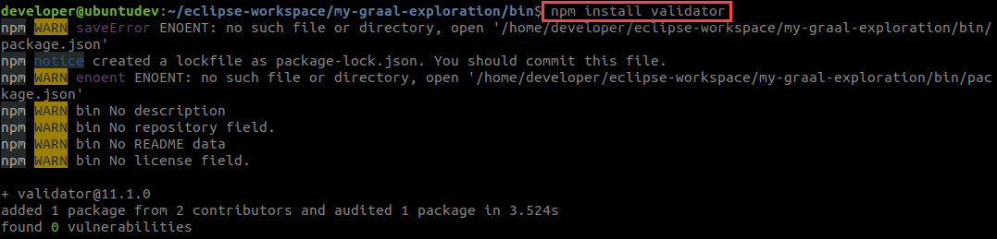
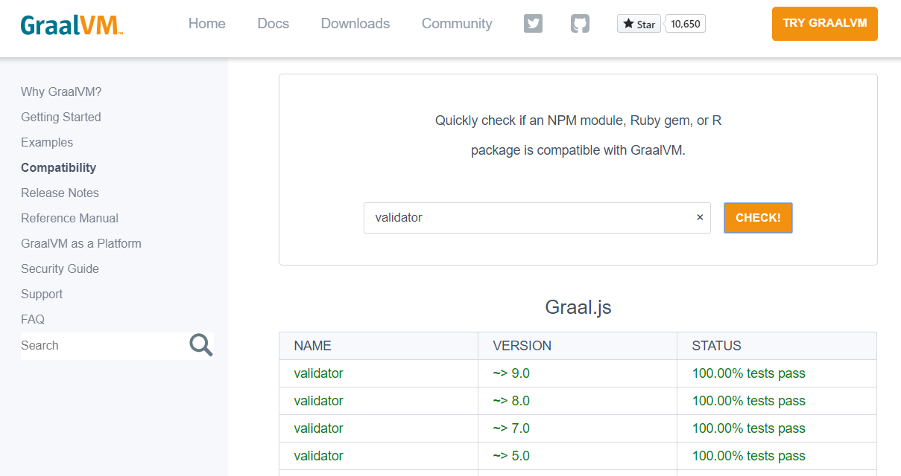
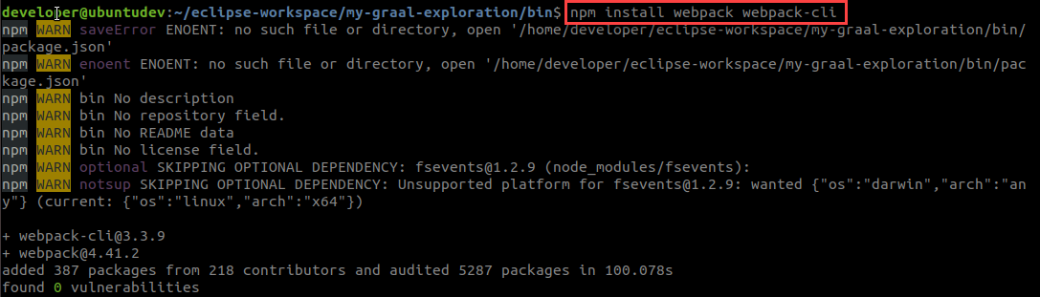
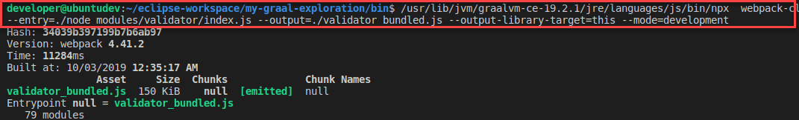
A Typical Java Challenge – Resolved (with GraalVM)
Install npx
Install npm module Validator
Install webpack & webpack-cli
Produce a single bundle.js for Validator module
Notes:
https://www.npmjs.com/package/validator

Slide 40
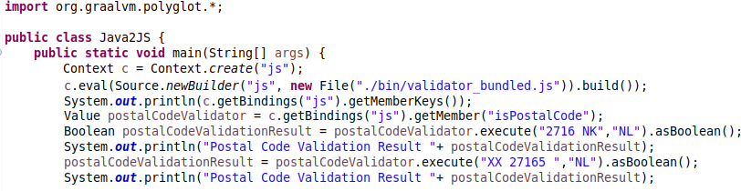
A Typical Java Challenge – Resolved (with GraalVM)
Notes:
https://www.npmjs.com/package/validator

Slide 41
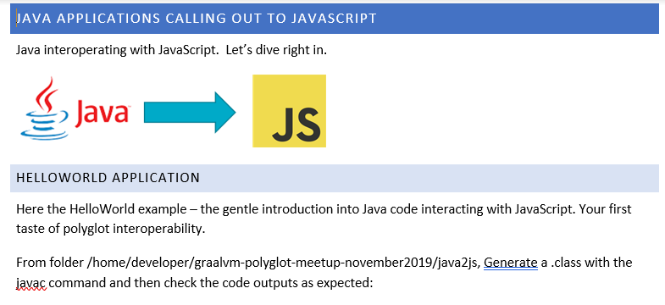
Workshop – Part One – Java => JavaScript
http://bit.ly/graal1411

Slide 42
GraalVM Polyglot Interoperability
Java => JavaScript
Java => Any Truffle Language (Python, R, Ruby, JavaScript)
Native Image generation for Java Polyglot application
Node / JavaScript => Java
Node / JavaScript => Java => JavaScript
Any Truffle Language (Python, R, Ruby, JavaScript) ⬄ Any Truffle Language

Slide 43
Polyglot and Ahead of Time Compiled Native Binary
A multi-lingual or polyglot Java application can be turned into a Native Binary Executable using GraalVM Ahead of Time compilation
Non JVM-languages can be included but are not compiled ahead of time
The build process for the binary executable takes long & uses a lot of memory
The outcome: a single, smal[lish] file running on plain Linux with fast startup & low memory footprint
For example in Alpine Linux Container or in Linux Binary Serverless Function
Fortran
Haskell
GraalVM Polyglot
GraalVM
Native Image
(binary executable)
application

Slide 44
Native Binary Executable for Java Polyglot application
GraalVM Polyglot
A Java application that executes snippets of embedded, inline code in R, Python and JS
$GRAALVM_HOME/bin/native-image -cp ./application-bundle.jar
--language:js --language:python --language:R
--verbose -H:Name=myPolyglotApplication
-H:Class=nl.amis.AppStarter
Binary Executable myPolyglotApplication
Notes:
https://www.graalvm.org/docs/reference-manual/languages/js/
https://github.com/graalvm/graaljs/blob/master/docs/user/JavaInterop.md
Node.js applications running on GraalVM's JavaScript engine have access to all of Node.js' APIs, including built-in Node.js' modules such as 'fs', 'http', etc. Conversely, JavaScript code embedded in a Java application has access to limited capabilities, as specified through the Context API, and do not have access to Node.js' built-in modules.

Slide 45
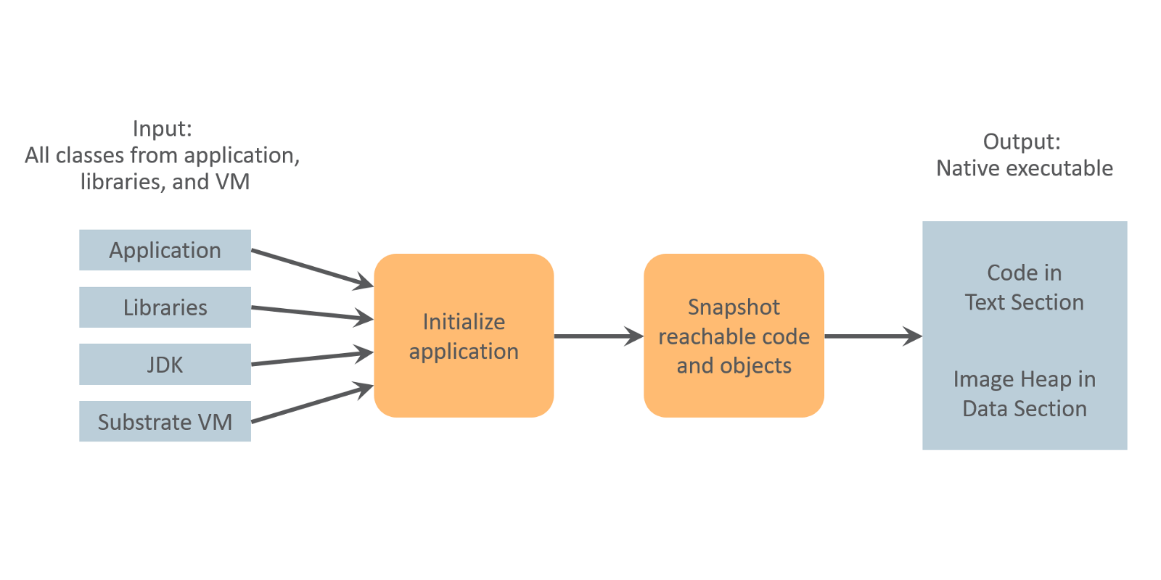
Native Image and Static Initializer
Classes can contain a static initializer – code to be executed at Class load time instead of Object creation time (per Class instance)
GraalVM Native Image can be instructed to initialize classes while creating the native image
to avoid running the same initialization code over and over again at every application start up.
Objects created during build time are available at run time in the so-called image heap.
The GraalVM Feature API provides more fine grained control
Notes:
https://medium.com/graalvm/updates-on-class-initialization-in-graalvm-native-image-generation-c61faca461f7
https://www.graalvm.org/sdk/javadoc/org/graalvm/nativeimage/hosted/Feature.html

Slide 46
Native Binary Executable for Java Polyglot application
When creating a native image for a Java application that calls JavaScript that is loaded from an external file …
… we want this file loading to take place in a static initializer
and instruct the GraalVM native image tool to initialize the class that loads this external resource at image build time
The JavaScript is loaded from the external file and its content stored in a String on the Image Heap inside the native image
Polyglot
(binary executable)
Application
GraalVM
Native Image
validatorbundled.js
Image Heap
String validatorbundled
Notes:
https://www.graalvm.org/docs/reference-manual/languages/js/
https://github.com/graalvm/graaljs/blob/master/docs/user/JavaInterop.md
Node.js applications running on GraalVM's JavaScript engine have access to all of Node.js' APIs, including built-in Node.js' modules such as 'fs', 'http', etc. Conversely, JavaScript code embedded in a Java application has access to limited capabilities, as specified through the Context API, and do not have access to Node.js' built-in modules.

Slide 47
Native Binary Executable for Java Polyglot application
Example of creating a binary image for a Java application that calls JavaScript and leverages an NPM module that is loaded from an external file at image build time:
Polyglot
validatorbundled.js
$GRAALVM_HOME/bin/native-image -cp ./application-bundle.jar --language:js -H:Name=postalCodeValidator -H:Class=nl.amis.java2js.ValidateThroughNPMValidator --initialize-at-build-time=nl.amis.java2js.ValidateThroughNPMValidator
-H:+ReportUnsupportedElementsAtRuntime --allow-incomplete-classpath
When running the binary executable – it contains and evaluates the String representation of the contents of file validatorbundled.js
Binary Executable postalCodeValidator/
Image Heap
./postalCodeValidator
String validatorbundled
Notes:
https://www.graalvm.org/docs/reference-manual/languages/js/
https://github.com/graalvm/graaljs/blob/master/docs/user/JavaInterop.md
Node.js applications running on GraalVM's JavaScript engine have access to all of Node.js' APIs, including built-in Node.js' modules such as 'fs', 'http', etc. Conversely, JavaScript code embedded in a Java application has access to limited capabilities, as specified through the Context API, and do not have access to Node.js' built-in modules.

Slide 48
Native Binary Executable for Java Polyglot application
Example of creating a binary image for a Java application that calls JavaScript and leverages an NPM module that is loaded from an external file at run time:
Polyglot
validatorbundled.js
$GRAALVM_HOME/bin/native-image -cp ./application-bundle.jar --language:js -H:Name=postalCodeValidator -H:Class=nl.amis.java2js.ValidateThroughNPMValidator2
-H:+ReportUnsupportedElementsAtRuntime
--allow-incomplete-classpath
When running the binary executable – pass the absolute location of the JavaScript module as argument and read the resource from that absolute path
Binary Executable postalCodeValidator
./postalCodeValidator ~/my-graal/validatorbundled.js
validatorbundled.js
Notes:
https://www.graalvm.org/docs/reference-manual/languages/js/
https://github.com/graalvm/graaljs/blob/master/docs/user/JavaInterop.md
Node.js applications running on GraalVM's JavaScript engine have access to all of Node.js' APIs, including built-in Node.js' modules such as 'fs', 'http', etc. Conversely, JavaScript code embedded in a Java application has access to limited capabilities, as specified through the Context API, and do not have access to Node.js' built-in modules.

Slide 49
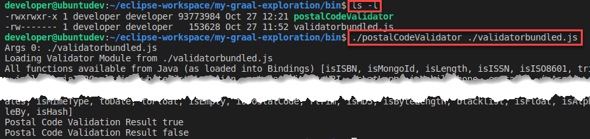
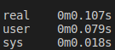
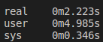
Native Binary Executable for Java Polyglot application
Timing comparison between Native Binary Executable and JIT execution:
User time 0.08 seconds vs 4.99 seconds mainly startup time.
Binary Executable postalCodeValidator
validatorbundled.js
Binary Executable
JIT Compilation
Notes:
https://www.graalvm.org/docs/reference-manual/languages/js/
https://github.com/graalvm/graaljs/blob/master/docs/user/JavaInterop.md
Node.js applications running on GraalVM's JavaScript engine have access to all of Node.js' APIs, including built-in Node.js' modules such as 'fs', 'http', etc. Conversely, JavaScript code embedded in a Java application has access to limited capabilities, as specified through the Context API, and do not have access to Node.js' built-in modules.

Slide 50
GraalVM Polyglot Interoperability
Java => JavaScript
Java => Any Truffle Language (Python, R, Ruby, JavaScript)
Native Image generation for Java Polyglot application
Node / JavaScript => Java
Node / JavaScript => Java => JavaScript
Any Truffle Language (Python, R, Ruby, JavaScript) ⬄ Any Truffle Language

Slide 51
Polyglot from non-JVM languages
Fortran
Any language running on GraalVM can participate in Polyglot interoperability
Evaluate & Execute Snippets in other languages
Export data and objects through the Polyglot Map to other execution contexts
Import data and objects from the Polyglot Map from other language contexts
Read, write & execute
Interacting with JVM based languages is slightly different
Use Java Type to construct native object based on a Java Class
Haskell
GraalVM Polyglot

Slide 52


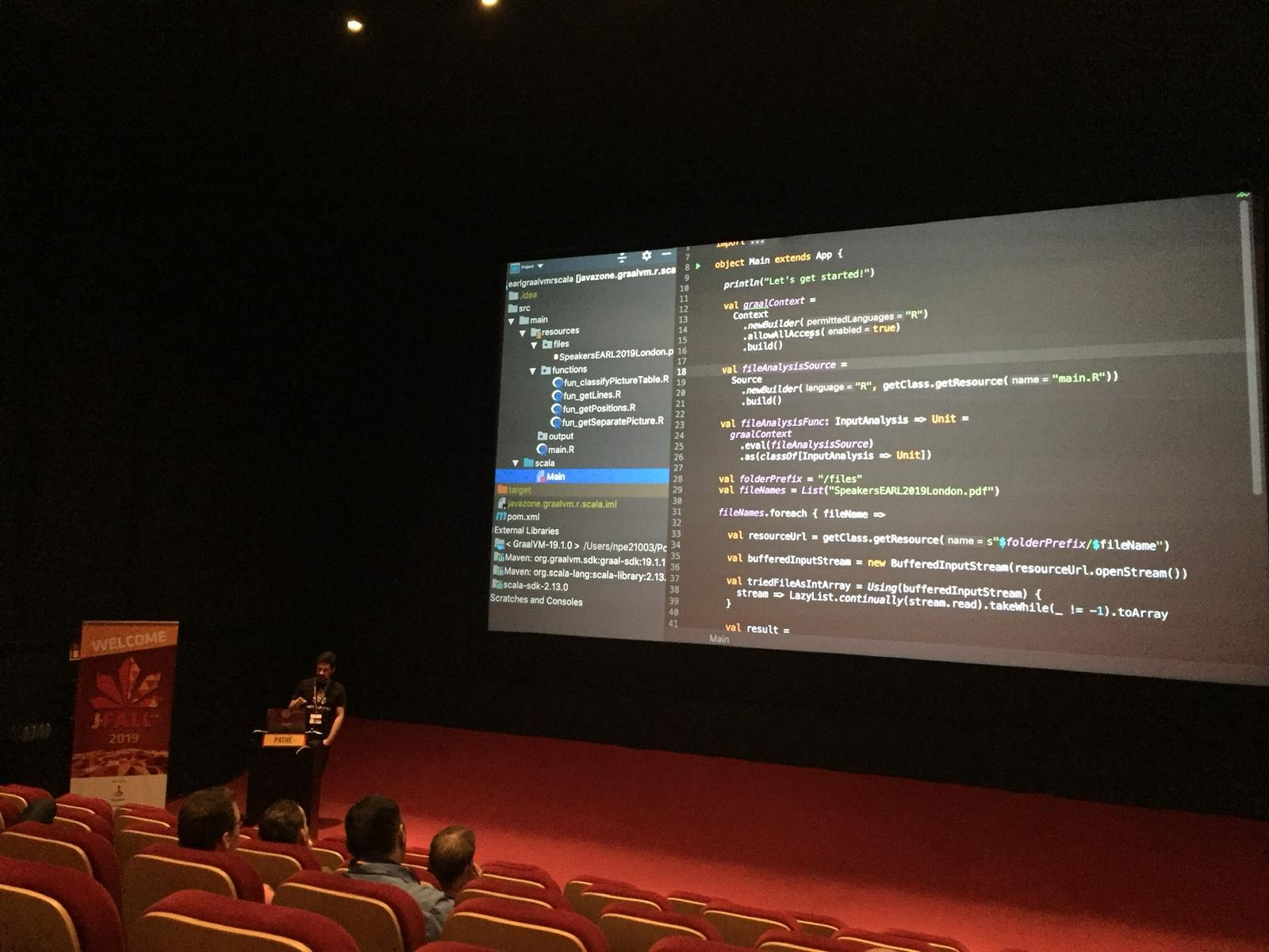

Polyglot from non-JVM languages JFall 2019 Show Case: Scala ⬄ (Fast)R on GraalVM
GraalVM Polyglot
-

Slide 53


Polyglot from JavaScript to Graal Truffle Languages
Polyglot.eval can execute any language snippet
It returns data objects (to read/write) or functions (that can be executed)
GraalVM Polyglot

Slide 54
Node Application calling out to Java (and others)
GraalVM can run Node & JS applications
GraalJS /GraalVM can replace V8 as interpreter & execution engine
GraalJS runs Java Byte code on JVM
This engine is a Java application that works on any Java 8+ implementation
Can run faster and better scalable to big memory structures
However: it may need some warmup time to reach peak performance
GraalVM 19.2.1: based on Node 10.16.3 and ECMAScript 2019 compliant
Node application running with GraalVM can leverage GraalVMs Polyglot – with Java as well as other languages (R, Ruby, Python, C++, …)
Evaluate Code Snippets, Instantiate Objects, Share Data
Notes:
var FileClass = Java.type('java.io.File'); var file = new FileClass("myFile.md");
https://www.graalvm.org/docs/reference-manual/languages/js/
https://github.com/graalvm/graaljs/blob/master/docs/user/JavaInterop.md
Node.js applications running on GraalVM's JavaScript engine have access to all of Node.js' APIs, including built-in Node.js' modules such as 'fs', 'http', etc. Conversely, JavaScript code embedded in a Java application has access to limited capabilities, as specified through the Context API, and do not have access to Node.js' built-in modules.

Slide 55


Node Application calling out to Java
application-bundle.jar
Node Application
Joker.class
GraalJS
Java 8 APIs
JVM & GraalVM
Notes:
var FileClass = Java.type('java.io.File'); var file = new FileClass("myFile.md");
https://www.graalvm.org/docs/reference-manual/languages/js/
https://github.com/graalvm/graaljs/blob/master/docs/user/JavaInterop.md
Node.js applications running on GraalVM's JavaScript engine have access to all of Node.js' APIs, including built-in Node.js' modules such as 'fs', 'http', etc. Conversely, JavaScript code embedded in a Java application has access to limited capabilities, as specified through the Context API, and do not have access to Node.js' built-in modules.

Slide 56

Node Application calling out to Java
Get hold of Java Class and instantiate Java Object
Invoke method on Object and get String returned
application-bundle.jar
Node Application
Joker.class
Notes:
var FileClass = Java.type('java.io.File'); var file = new FileClass("myFile.md");
https://www.graalvm.org/docs/reference-manual/languages/js/
https://github.com/graalvm/graaljs/blob/master/docs/user/JavaInterop.md
Node.js applications running on GraalVM's JavaScript engine have access to all of Node.js' APIs, including built-in Node.js' modules such as 'fs', 'http', etc. Conversely, JavaScript code embedded in a Java application has access to limited capabilities, as specified through the Context API, and do not have access to Node.js' built-in modules.

Slide 57


Node Application calling out to Java (and JavaScript)
Leverages NPM Validator module
application-bundle.jar
Node Application
validator-bundle.js
Notes:
var FileClass = Java.type('java.io.File'); var file = new FileClass("myFile.md");
https://www.graalvm.org/docs/reference-manual/languages/js/
https://github.com/graalvm/graaljs/blob/master/docs/user/JavaInterop.md
Node.js applications running on GraalVM's JavaScript engine have access to all of Node.js' APIs, including built-in Node.js' modules such as 'fs', 'http', etc. Conversely, JavaScript code embedded in a Java application has access to limited capabilities, as specified through the Context API, and do not have access to Node.js' built-in modules.

Slide 58
GraalVM Polyglot Interoperability
Java => JavaScript
Java => Any Truffle Language (Python, R, Ruby, JavaScript)
Native Image generation for Java Polyglot application
Node / JavaScript => Java
Node / JavaScript => Java => JavaScript
Any Truffle Language (Python, R, Ruby, JavaScript) ⬄ Any Truffle Language

Slide 59
Polyglot from Python with other Graal Truffle Languages
GraalVM Polyglot
type
eval
eval

Slide 60
Polyglot from Python with other Graal Truffle Languages
GraalVM Polyglot
Get Java Class, Instantiate Object and Read/Write/Invoke
type

Slide 61
Polyglot from Python with other Graal Truffle Languages
GraalVM Polyglot
export_value
Polyglot.import
title
“Polyglot Programming”
eval
function(name) {
print(`Title from polyglot ${Polyglot.import('title')}`);
return `Hello ${name}, welcome to the world of JavaScript`; }

Slide 62
Polyglot from Python with other Graal Truffle Languages
GraalVM Polyglot
export_value
Polyglot.import
title
“Polyglot Programming”
eval
squared
x => {print(x); return x * x}
import_value
Polyglot.export

Slide 63


Polyglot from Python with other Graal Truffle Languages
GraalVM Polyglot
“Polyglot Programming”
title
eval
squared
x => {print(x); return x * x}
eval

Slide 64
Polyglot Example with Node, Java, Python and R
A Node application that calls on many friends and libraries
GraalVM Polyglot
Notes:
var FileClass = Java.type('java.io.File'); var file = new FileClass("myFile.md");
https://www.graalvm.org/docs/reference-manual/languages/js/
https://github.com/graalvm/graaljs/blob/master/docs/user/JavaInterop.md
Node.js applications running on GraalVM's JavaScript engine have access to all of Node.js' APIs, including built-in Node.js' modules such as 'fs', 'http', etc. Conversely, JavaScript code embedded in a Java application has access to limited capabilities, as specified through the Context API, and do not have access to Node.js' built-in modules.

Slide 65
Conclusion

Slide 66

Quick Recap – What is GraalVM?
Thomas Wuerthinger: “a new virtual machine that is trying to execute many languages faster”
JIT Foundation for the Long Term Evolution of HotSpot JVM
Stable, observable, manageable and maintainable JVM with optimizations for modern Java and JVM language patterns
Serverless Java
Small footprint, rapid startup time, simple & small run time
Interoperability platform aka Polyglot VM
Run and interact between many languages
Bonus features
Custom DSL
Native interaction between C/C++ and Java
Polyglot Tools: Debugger (with Chrome Dev Tools), Profiler, GraalVM VisualVM, Ideal Graph Visualizer, Visual Studio Code extension for GraalVM
Notes:
https://www.graalvm.org/docs/reference-manual/tools

Slide 67

What’s Next?
GraalVM 19.3 – 19th November 2019
Java 11 support!
GraalVM runtime and native binary for Serverless frameworks and FaaS
Project Fn provides GraalVM support today, native image can run on many FaaS
GraalVM further AOT support in many Java frameworks
Spring 5.3 GraalVM Native Image support – 1H 2020 (Initial support since 5.1)
Oracle Database has preview with Multi Language Engine for Stored Procedures in Python, JavaScript and more
Oracle WebLogic 14 plans to support GraalVM as its runtime
19th November 2019

Slide 68


Adopting GraalVM in your team - your first steps
Start exploring GraalVM – download & install, play and do a PoC
Plenty of resources available (code samples, blog articles, tutorials, ..)
Hybrid: have some containers running GraalVM (for Java applications) instead of your traditional JVM brand
to try out, check if it is stable and performant and (better) manageable
Start leveraging polyglot
single runtime for different programming languages)
interoperability (benefit in Java from 3rd party libraries in JavaScript or Python [or vice versa] and/or make better use of the skills in your team)
better start creating standards and guidelines around when and how to polyglot!
AOT/native - use GraalVM to build Java applications as native executables as last step in the build process and deliver that executable instead of JAR files
create Java based Serverless Functions with small footprint and very quick startup
benefit from ultra fast and super small frameworks (Quarkus, Helidon, Micronaut, Vert.x, Spring, …)
Haskell
Fortran
GraalVM Polyglot

Slide 69


Workshop – Part Two – Node/JS => Java and beyond
http://bit.ly/graal1411

Slide 70
Thank you!

